Slide 1
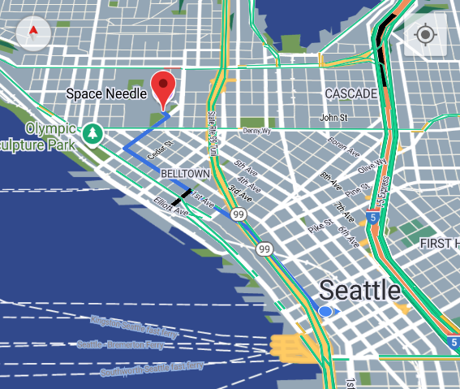
WEATHER DRIVER NAVIGATING THROUGH HAZARDOUS WEATHER
Aaron Jeromsky
Jordan Fleming
Notes:
TODO:
• Swap out the image for something that works for you
• Read these notes carefully
• Read the “Appendix: Rubric” slide (at the end of this deck) carefully so you know what people are looking for

Slide 2
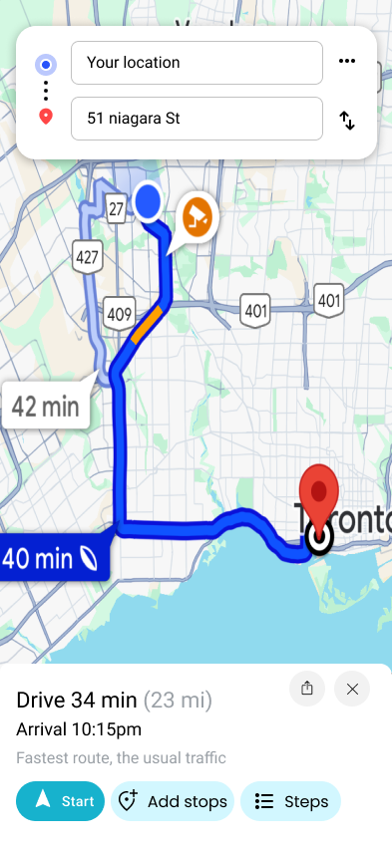
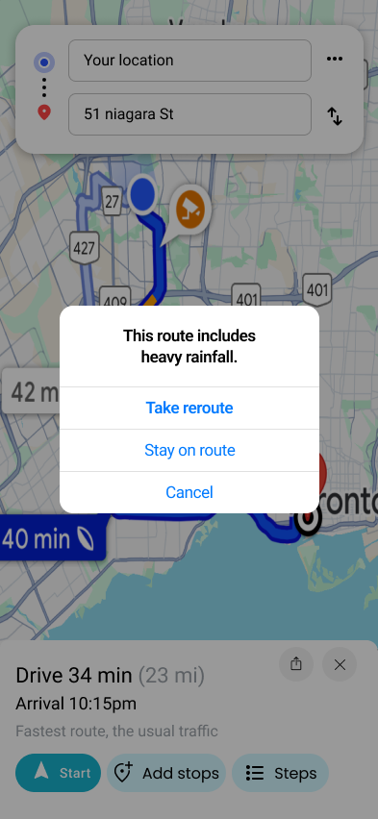
CONCEPT
User-friendly mobile app for planning routes and receiving relevant weather information and alerts about hazardous conditions, such as storms and tornados.
Offer the ability to find detours to avoid unpleasant or dangerous conditions.
Support multiple routing plans (fastest, cheapest, most refueling stations). User account settings for specifying weather alert preferences.
Notes:
TODO:
• Add objectives
• Add images if desired

Slide 3
OBJECTIVES
Features:
Search for locations and receive directions for them
Reroute to avoid hazardous conditions
Highlight business locations such as refueling stations and motels
Account management and customization options
Specifications:
Develop the application in React Native to support both Android and iOS
Use Google API services for the map interface and features
Obtain weather data through the NOAA API web service
Support CRUD operations through AWS to send and receive weather data
Notes:
TODO:
• Add objectives
• Add images if desired

Slide 4
CHALLENGES
Building a mobile app from the ground up
Researching and comparing API options and features
Evolving deliverables and criteria
Frequent iterating on components and designs
Communicating between the frontend and backend of the project
Notes:
TODO:
• Add objectives
• Add images if desired

Slide 5
GROWTH
Programming Languages:
React Native
TypeScript
Tools and Services:
Expo Go
AWS services (Cognito, S3, Lambda)
Google API services (Places, Geocoding, Directions)
Android Studio and Emulation
Communication:
Creating meeting plans and notes
Weekly meetings with employer for frequent iteration
Notes:
TODO:
• Add growth notes
• Add images if desired

Slide 6
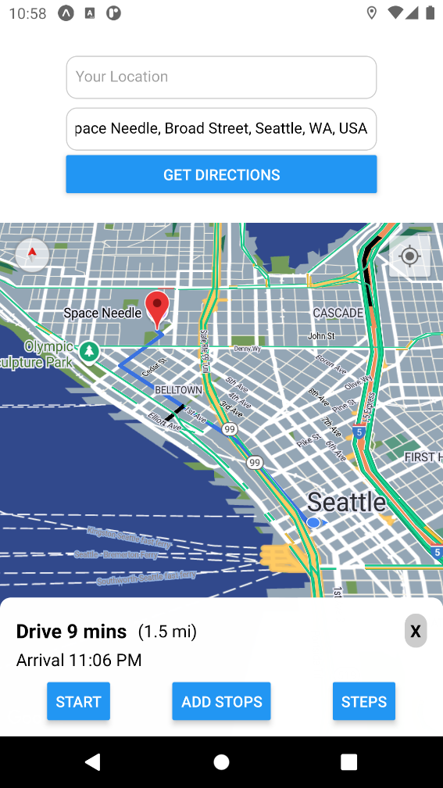
IMPACT
Safer route planning around potentially hazardous road conditions
Mobile development career path
Publishing to Google Play and/or Apple App Store
Potential employment from company if investor interest is found
Notes:
TODO:
• Add growth notes
• Add images if desired

Slide 7

DEMONSTRATION
Notes:
TODO:
• Get the audience ready for the demo
• Add an image if desired
• During the demo, come back through objectives, growth, and impact

Slide 8

Q & A
Notes:
TODO: Replace the artwork, if desired.

